Slide 1
DATA SUFFICIENCY
By:-
Naveen Kumar Jain
(Aptitude Trainer)

Slide 2
INTRODUCTION
Data Sufficiency is to check and test the given set of information, whether it is enough to answer a question or not.
Data Sufficiency-type questions are designed to test the candidate's ability to relate given information to reach a conclusion.
Moreover, the data sufficiency has wider attributes to test the candidate.
On one hand, it may have problems from any of the topics of reasoning or Quantitative aptitude
on the other hand, it can test a candidate’s analytical skills.

Slide 3
How to Solve Data Sufficiency Questions
The step by step process for solving Data sufficiency includes:
In Data Sufficiency, candidates only need to check whether the data provided is sufficient or not to find the answer. Therefore, do not waste time in finding the final answer.
Data Sufficiency problems appear to be difficult at first because of the complicated directions, but once you get familiar with these directions, you will find these problems easy to solve. Never assume anything by yourself.
Always read the question carefully and identify the specific information required to answer the question. Read the statements carefully and understand them and then finally analyze the statements and try to eliminate some answer choices. This will help you increase your chances of gaining points by guessing the answer.

Slide 4
PRACTICE QUESTIONS
Question: In which year was Rahul born ?
Statements:
Rahul at present is 25 years younger to his mother.
Rahul's brother, who was born in 1964, is 35 years younger to his mother.
A. I alone is sufficient while II alone is not sufficient
B. II alone is sufficient while I alone is not sufficient
C. Either I or II is sufficient
D. Neither I nor II is sufficient
E. Both I and II are sufficient
From both I and II, we find that Rahul is (35 - 25) = 10 years older than his brother, who was born in 1964. So, Rahul was born in 1954.
Ans E

Slide 5
PRACTICE QUESTIONS
Question: What will be the total weight of 10 poles, each of the same weight ?
Statements:
One-fourth of the weight of each pole is 5 kg.
The total weight of three poles is 20 kilograms more than the total weight of two poles.
A. I alone is sufficient while II alone is not sufficient
B. II alone is sufficient while I alone is not sufficient
C. Either I or II is sufficient
D. Neither I nor II is sufficient
E. Both I and II are sufficient
From I, we conclude that weight of each pole = (4x5) kg = 20 kg.
So, total weight of 10 poles = (20 x 10) kg = 200 kg.
From II, we conclude that:
Weight of each pole = (weight of 3 poles) - (weight of 2 poles) = 20 kg.
So, total weight of 10 poles = (20 x 10) kg = 200 kg.
Ans C

Slide 6
PRACTICE QUESTIONS
There are four plateaus on a mountain labeled M, N, O and P. M is 2200 meters above the ground. N is 600 meters higher than M. P is 1000 meters higher than O. Is N higher than O?
Statements
I P is 2600 m above the ground
II P is 400 higher than M
A. Either I or II is sufficient
B. Neither I nor II is sufficient
C. Both I and II are sufficient
D. I alone is sufficient while II alone is not sufficient
Statement I: From the given information we have N higher than O by 2800 - 1600 i.e. 1200 m. Therefore, statement I alone is sufficient.
Statement II: From the given information N is higher than O by 1200 m. Therefore, statement II alone is sufficient.
Hence answer is (a)

Slide 7
PRACTICE QUESTIONS
Question: How much was the total sale of the company ?
Statements:
The company sold 8000 units of product A each costing Rs. 25.
This company has no other product line.
A. I alone is sufficient while II alone is not sufficient
B. II alone is sufficient while I alone is not sufficient
C. Either I or II is sufficient
D. Neither I nor II is sufficient
E. Both I and II are sufficient
From I, total sale of product A = Rs. (8000 x 25) = Rs. 200000.
From II, we know that the company deals only in product A.
This implies that sale of product A is the total sale of the company, which is Rs. 200000.
Ans E
Hence both are sufficient to answer the questions.

Slide 8
PRACTICE QUESTIONS
Identify which statement is sufficient to answer the given question.
Is P - 5 even? P is real number.
i. P - 15 is an integer.
ii. P - 10 is an odd integer.
A. If statement i alone is sufficient but statement ii alone is not sufficient.
B. If statement ii alone is sufficient but statement i alone is not sufficient.
C. If both statements i and ii together are sufficient but neither of statements alone is sufficient.
D. If each statement alone is sufficient.
Statement I: Since P - 15 is an integer, P is an integer. Therefore statement I alone is not sufficient.
Statement II: P - 10 is an odd integer. Therefore P is an odd integer. So P - 5 is an even number.
Therefore statement II alone is sufficient.
Ans B

Slide 9
PRACTICE QUESTIONS
What is the total cost of tiles needed for a room 9 feet by 12 feet?
I Tiles are 6" square each.
II Tiles cost Rs.10 per Sq. ft.
A. If statement i alone is sufficient but statement ii alone is not sufficient.
B. If statement ii alone is sufficient but statement i alone is not sufficient.
C. If both statements i and ii together are sufficient but neither of statements alone is sufficient.
D. If each statement alone is sufficient.
Statement I alone is not sufficient as we don’t know the cost of one tile.
Statement II: Total cost = 9 x 12 x 10 = Rs 1080.
Therefore, statement II alone is sufficient. Hence answer is (b).

Slide 10
PRACTICE QUESTIONS
Question: What is the code for 'sky' in the code language ?
Statements:
In the code language, 'sky is clear' is written as 'de ra fa'.
In the same code language, 'make it clear' is written as 'de ga jo'.
A. I alone is sufficient while II alone is not sufficient
B. II alone is sufficient while I alone is not sufficient
C. Either I or II is sufficient
D. Neither I nor II is sufficient
E. Both I and II are sufficient
The only word common to I and II is 'clear' and as such, only the code for 'clear' can be ascertained from the given information.
Ans D Neither I nor II is sufficient

Slide 11
PRACTICE QUESTIONS
Is z less than w? z and w real numbers.
I z² = 25
II w = 9
A. If statement i alone is sufficient but statement ii alone is not sufficient.
B. If statement ii alone is sufficient but statement i alone is not sufficient.
C. If both statements i and ii together are sufficient but neither of statements alone is sufficient.
D. If each statement alone is sufficient.
Statement I: We have, z = +5. Therefore the statement I alone is not sufficient as we don’t know the value of w.
Both statement together give w > z. Hence answer is c

Slide 12
PRACTICE QUESTIONS
When was Raju born?
I. Raju was born on the same day that of Mr. Gandhi was
II. Mr. Gandhi was born in October.
A. If statement i alone is sufficient but statement ii alone is not sufficient.
B. If statement ii alone is sufficient but statement i alone is not sufficient.
C. If both statements i and ii together are sufficient but neither of statements alone is sufficient.
D. If both statements i and ii together are not sufficient to answer the question.
We SHOULD NOT assume that Mr. Gandhi mentioned here is the Father of the Nation.
Specific information is required to come to any such conclusion.
Hence, even after combining both the statements, we cannot answer this question.

Slide 13
PRACTICE QUESTIONS
Answer which of the statement is sufficient to answer the given question.
In the rectangle ABCD, what is the length?
I Area of rectangle is 55 Sq.units.
II AC = 30 units.
A. If statement I alone is sufficient but statement ii alone is not sufficient.
B. If statement II alone is sufficient but statement i alone is not sufficient.
C. If both statements I and II together are sufficient but neither of statements alone is sufficient.
D. If each statement alone is sufficient.
Let l and b are the length and breath of the rectangle.
Then statement I gives lb = 55. Now statement I alone is not sufficient as we don’t know the breath of the rectangle.
Hence answer is If both statements i and ii together are sufficient but neither of statements alone is sufficient.
Statement II gives l2 + b2=900, So statement II alone is not sufficient.
Both the statements together can give the value of length of the rectangle.

Slide 14
Directions: Each of the questions below consists of a question and two statements numbered I and II given below it. You have to decide whether the data provided in the statements are sufficient to answer the question. Read both the statements and give answer:
A. the data in statement I alone is sufficient to answer the question, while the data in statement II alone is not sufficient to answer the question.
B. the data in statements II alone is sufficient to answer the question, while the data in statement I alone is not sufficient to answer the question.
C. Either Statement I or Statement II alone is sufficient to answer the question.
D. Neither statement I nor statement II is sufficient to answer the questions.
E. The data in both the statements I and II together is necessary to answer the question.
1. Two friends A and B together can complete a piece of work in 10 days. In how many days A alone complete the piece of work?
Statement I: B alone can complete half of the work in 12.5 days.
Statement II: The efficiency of A is 50% more than that of B.

Slide 15
2. When length of a rectangle was increased by 20% and breadth remains constant then area was increased by 100 sq. cm. What is the perimeter of the rectangle?
Statement I: After increasing the length, the rectangle becomes a square.
Statement II: After increasing the length, all the angles of the rectangle become 90 degree.

Slide 16
3. One day I left my home at 7 : 00 AM and assumed that if I run at uniform speed then I will reach my school at 12 : 00 AM. If my brother left the school for home at 8 : 00 AM with his uniform speed, then at what time would he meet me?
Statement I: The uniform speed of my brother is 14 km per hour.
Statement II: He can reach home at 11:30 AM.

Slide 17
5 years ago, Ram was 5 times as old as me. At present, what is the age of Ram?
Statement I: 2 years ago, Ram got married and at present, the average age of Ram and his wife is 52 years.
Statement II: 5 years hence, Ram will be 2 times as old as his wife.

Slide 18
Is x an even number?
Statement I: 8x + 5y is an even number.
Statement II: 3x + 6y is an even number

Slide 19
A boy riding a bicycle at a uniform speed, complete a round of a square park in 30 seconds. What is the area of the park?
Statement I: The uniform speed of the boy is 20 meters per second
Statement II: One side of the park is 150 meters.

Slide 20
7. The length of the train how much percentage less than that of the platform of length x meters?
Statement I: The train cross the x meters long platform in 30 seconds.
Statement II: The train crosses a signal pole in 15 seconds

Slide 21
QUANTITATIVE APTITUDE
DATA INTERPRETATION
By:-
Naveen Kumar Jain
(Aptitude Trainer)

Slide 22
INTRODUCTION
Data interpretation is the process of reviewing data and drawing meaningful conclusions using a variety of analytical approaches.
Data Interpretation questions are based on the information given in the tables and graphs, charts.

Slide 23
How to Solve DI Questions
The step by step process for Interpreting Data includes:
Collect The Information You’ll Need To Interpret Data – collect all the information you will need to interpret the data. Put all this information into easy to read tables, graphs, charts etc.
Develop findings of Your Data – develop observations about your data, summarize the important points, and find the conclusion because that will help you form a more accurate Interpretation.
Development of the Conclusion – the conclusion is remarked as an explanation of your data. The conclusion should relate to your data.
Develop The Recommendations of Your Data – the recommendation of your data should be based on your conclusion and findings.

Slide 24
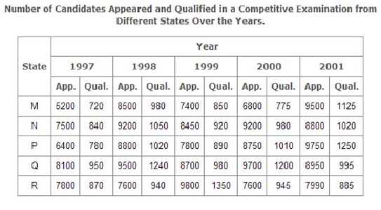
TABULAR BASED DI Questions
Study the following table and answer the questions.
Total number of candidates qualified from all the states together in 1997 is approximately what percentage of the total number of candidates qualified from all the states together in 1998?
A.72 % B. 77% C. 80% D. 83 %
Required percentage
(720 + 840 + 780 + 950 + 870
x 100 %
=
980 + 1050 + 1020 + 1240 + 940
4160
=
x 100 %
5230
= 79.54%
~= 80%
Ans C

Slide 25
TABULAR BASED DI Questions
Study the following table and answer the questions.
What is the average candidates who appeared from State Q during the given years?
A. 8700 B. 8760 C. 8990 D. 8920
Required average
8100 + 9500 + 8700 + 9700 + 8950
=
5
=8990
Ans C

Slide 26
TABULAR BASED DI Questions
Study the following table and answer the questions.
In which of the given years the number of candidates appeared from State P has maximum percentage of qualified candidates?
A. 1997 B. 1998 C. 1999 D. 2000
ANS D
The percentages of candidates qualified to candidates appeared from State P during different years are
780
For 1997
=
×100 %
=12.19 %
6400
1020
For 1998
=
×100 %
=11.59 %
8800
880
For 1999
=
×100 %
=11.41 %
7800
1010
For 2000
=
×100 %
=12.82 %
8750

Slide 27
TABULAR BASED DI Questions
Study the following table and answer the questions.
What is the percentage of candidates qualified from State N for all the years together, over the candidates appeared from State N during all the years together?
A.12.36 % B. 12.16% C. 11.47% D. 11.15 %
Required percentage
840 + 1050 + 920 + 980 + 1020
x 100 %
=
7500 + 9200 + 8450 + 9200 + 8800
4810
=
x 100 %
43150
= 11.15%
Ans D

Slide 28
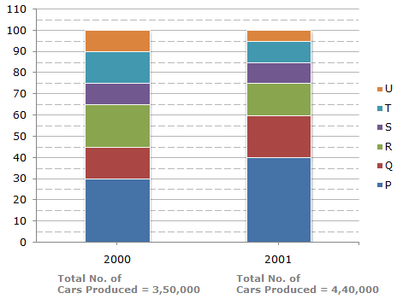
BAR GARPH
Bar Graphs –
By using bar graphs we can interpret the relationship between the variables in the form of rectangular bars. These rectangular bars could be drawn either horizontally or vertically. The different categories of data are represented by bars and the length of each bar represents its value. Some types of bar graphs include grouped graphs, segmented graphs, stacked graphs etc.

Slide 29
BAR GRAPH BASED DI Questions
The bar graph given below shows the percentage distribution of the total production of a car manufacturing company into various models over two years.
What was the difference in the number of Q type cars produced in 2000 and that produced in 2001?
A. 35,500 B. 27,000
C. 22,500 D.17,500
Total number of Q type cars produced in 2001
=(60 - 40)% of 4,40,000
= 88,000
Total number of Q type cars produced in 2000
=(45 - 30)% of 3,50,000
= 52,500
Required difference =
88000 - 52500
= 35,500
Ans A

Slide 30
BAR GRAPH BASED DI Questions
The bar graph given below shows the percentage distribution of the total production of a car manufacturing company into various models over two years.
If the percentage production of P type cars in 2001 was the same as that in 2000, then the number of P type cars produced in 2001 would have been?
A. 1,40,000 B. 1,32,000
C. 1,17,000 D. 1,05,000
If the percentage production of P type cars in 2001
= Percentage production of P type cars in 2000
= 30%.
then, number of P type cars produced in 2001
= 30% of 4,40,000
= 1,32,000
Ans B

Slide 31
BAR GRAPH BASED DI Questions
The bar graph given below shows the percentage distribution of the total production of a car manufacturing company into various models over two years.
If 85% of the S type cars produced in each year were sold by the company, how many S type cars remain unsold?
A. 7650 B. 9350 C. 11,850 D. 12,250
Number of S type cars which remained unsold in 2000
= 15% of 350,000
number of S type cars which remained unsold in 2001
= 15% of 440,000.
Total number of S type cars which remained unsold
= 15% of (350,000 + 440,000)
= 15% of 790,000
= 11,850.
Ans C

Slide 32
BAR GRAPH BASED DI Questions
The bar graph given below shows the percentage distribution of the total production of a car manufacturing company into various models over two years.
For which model the percentage rise/fall in production from 2000 to 2001 was minimum?
A. Q B. R C. S D. T
The percentage change (rise/fall) in production from 2000 to 2001 for various models is:
For Q
67.62%, rise
For R
5.71%, fall
For S
25.71%, rise.
For T
16.19%, fall

Slide 33
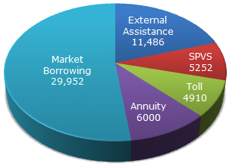
PIE CHART
Pie Chart –
The circular graph used to represent the percentage of a variable is called a pie chart. The pie charts represent numbers as proportions or percentages. Some types of pie charts are simple pie charts, doughnut pie charts, and 3D pie charts.

Slide 34
PIE CHART BASED DI Questions
The following pie-chart shows the sources of funds to be collected by the National Highways Authority of India (NHAI) for its Phase II projects. Study the pie-chart and answers the question that follow.
Sources of funds to be arranged by NHAI for Phase II projects (in crores Rs.)
Near about 20% of the funds are to be arranged through:
A. SPVS B. External Assistance
C. Annuity D. Market Borrowing
20% of the total funds to be arranged
= Rs. (20% of 57600) crores
= Rs. 11520 crores
Rs.11486 crores (Approx)
Rs. 11486 crores is the amount of funds to be arranged through External Assistance.

Slide 35
PIE CHART BASED DI Questions
The following pie-chart shows the sources of funds to be collected by the National Highways Authority of India (NHAI) for its Phase II projects. Study the pie-chart and answers the question that follow.
Sources of funds to be arranged by NHAI for Phase II projects (in crores Rs.)
If NHAI could receive a total of Rs. 9695 crores as External Assistance, by what percent (approximately) should it increase the Market Borrowing to arrange for the shortage of funds?
A. 4.5% B.7.5% C.6% D. 8%
Shortage of funds arranged through External Assistance
= Rs. (11486 - 9695) crores
= Rs. 1791 crores.
Increase required in Market Borrowing
= Rs. 1791 crores.
1791
Percentage increase required =
X100%
= 5.98%
=
Ans C
29952

Slide 36
PIE CHART BASED DI Questions
The following pie-chart shows the sources of funds to be collected by the National Highways Authority of India (NHAI) for its Phase II projects. Study the pie-chart and answers the question that follow.
Sources of funds to be arranged by NHAI for Phase II projects (in crores Rs.)
If the toll is to be collected through an outsourced agency by allowing a maximum 10% commission, how much amount should be permitted to be collected by the outsourced agency, so that the project is supported with Rs. 4910 crores?
A. Rs. 6213 crores B.Rs. 5827 crores
C. Rs. 5401 crores D. Rs. 5316 crores
= (Funds required from Toll for projects of Phase II) +
Amount permitted
(10% of these funds)
= Rs. 4910 crores
+ Rs. (10% of 4910) crores
= Rs. (4910 + 491) crores
= Rs. 5401 crores
Ans C

Slide 37
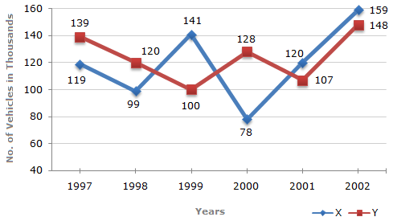
LINE GRAPH
Line Graph –
the charts or graphs that show information in a series of points are included in the line graphs. Line charts are very good to visualise continuous data or sequence of values. Some of the types of line graphs are simple line graphs, stacked line graphs etc.

Slide 38
LINE GRAPH BASED DI Questions
Study the following line graph and answer the questions based on it.
Number of Vehicles Manufactured by Two companies over the Years (Number in Thousands)
What is the difference between the number of vehicles manufactured by Company Y in 2000 and 2001 ?
A. 50000 B.42000 C. 33000 D. 21000
Required difference
= (128000 - 107000)
= 21000.
Ans D

Slide 39
LINE GRAPH BASED DI Questions
Study the following line graph and answer the questions based on it.
Number of Vehicles Manufactured by Two companies over the Years (Number in Thousands)
What is the difference between the total productions of the two Companies in the given years ?
A. 19000 B. 22000 C. 26000 D. 28000
Total production of Company X from 1997 to 2002
= 119000 + 99000 + 141000 + 78000 + 120000 + 159000
= 716000.
and total production of Company Y from 1997 to 2002
= 139000 + 120000 + 100000 + 128000 + 107000 + 148000
= 742000
Difference =
(742000 - 716000)
= 26000
Ans C

Slide 40
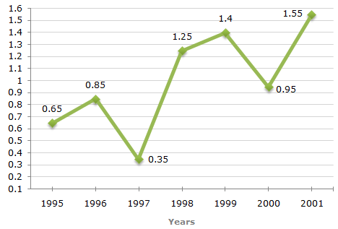
LINE GRAPH BASED DI Questions
The following line graph gives the ratio of the amounts of imports by a company to the amount of exports from that company over the period from 1995 to 2001.
Ratio of Value of Imports to Exports by a Company Over the Years.
The imports were minimum proportionate to the exports of the company in the year ?
A. 1995 B. 1996
C. 1997 D. 2000
The imports are minimum proportionate to the exports implies that the ratio of the value of imports to exports has the minimum value.
Now, this ratio has a minimum value 0.35 in 1997, i.e., the imports are minimum proportionate to the exports in 1997.

Slide 41
LINE GRAPH BASED DI Questions
The following line graph gives the ratio of the amounts of imports by a company to the amount of exports from that company over the period from 1995 to 2001.
Ratio of Value of Imports to Exports by a Company Over the Years.
What was the percentage increase in imports from 1997 to 1998 ?
A. 72 B. 56 C. 28
D. Data inadequate
The graph gives only the ratio of imports to exports for different years.
To find the percentage increase in imports from 1997 to 1998, we require more details such as the value of imports or exports during these years.
Hence, the data is inadequate to answer this question.

Slide 42
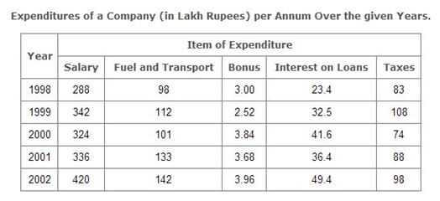
TYPES OF DI QUESTIONS: TABLE
Statistical data are represented by tables. The data are placed in rows and columns. Types of tables include simple tables and complex tables.
Study the following table and answer the question(s) based on it.
The total expenditure of the company over these items during the year 2000 is?
A. Rs. 544.44 lakhs B. Rs. 501.11 lakhs
C. Rs. 446.46 lakhs D. Rs. 478.87 lakhs
Total expenditure of the Company during 2000
= Rs. (324 + 101 + 3.84 + 41.6 + 74) lakhs
= Rs. 544.44 lakhs.
Option A

Slide 43
TYPES OF DI QUESTIONS
What is the average amount of interest per year which the company had to pay during this period?
A. Rs. 32.43 lakhs B. Rs. 33.72 lakhs
C. Rs. 34.18 lakhs D. Rs. 36.66 lakhs
Average amount of interest paid by the Company during the given period
= Rs. [ 23.4 + 32.5 + 41.6 + 36.4 + 49.4 ]L
5
= Rs. [ 183.3 ]/5 lakhs
= Rs. 36.66 lakhs.
Option D

Slide 44
LINE GRAPH BASED DI Questions
The total amount of bonus paid by the company during the given period is approximately what percent of the total amount of salary paid during this period?
A. 0.001% B. 0.05% C. 0.01% D. 1%
Required percentage
(3.00 + 2.52 + 3.84 + 3.68 + 3.96)
x 100 %
(288 + 342 + 324 + 336 + 420)
= [ 17/1710 ] x 100
= 1%
Ans D

Slide 45
LINE GRAPH BASED DI Questions
Study the following table and answer the question(s) based on it.
The ratio between the total expenditure on Taxes for all the years and the total expenditure on Fuel and Transport for all the years respectively is approximately?
A. 4:7 B. 10:13 C. 15:18 D. 5:8
Required ratio
= [ (83 + 108 + 74 + 88 + 98)
(98 + 112 + 101 + 133 + 142)
= [ 451/586]
= 10/13
Ans B

Slide 46
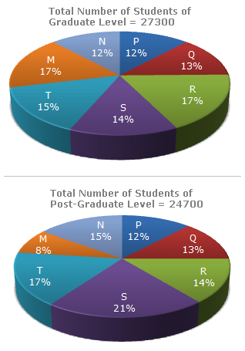
PIE CHART BASED DI Questions
The following pie-charts show the distribution of students of graduate and post-graduate levels in seven different institutes in a town.
Distribution of students at graduate and post-graduate levels in seven institutes:
What is the total number of graduate and post-graduate level students is institute R?
A. 8320 B. 7916
C. 9116 D. 8099
Required number
= (17% of 27300) + (14% of 24700)
= 4641 + 3458
= 8099

Slide 47
PIE CHART BASED DI Questions
The following pie-charts show the distribution of students of graduate and post-graduate levels in seven different institutes in a town.
Distribution of students at graduate and post-graduate levels in seven institutes:
What is the ratio between the number of students studying at post-graduate and graduate levels respectively from institute S?
A. 14 : 19 B. 19 : 21
C. 17 : 21 D.19 : 14
21% of 24700
Required ratio =
14% of 27300
21 x 24700
19
=
=
14 x 27300
14

Slide 48
THANK YOU

